Slide 1
Introduction to Robotics Course no. 0
Andrei Dumitriu
andrei.dumitriu@fmi.unibuc.ro
Faculty of Mathematics and Computer Science
University of Bucharest

Slide 2
Today’s agenda
Get to know each other
About you
About us
About the course
InnovationLabs, IdeaJam, SCSS, Robochallenge, funding & incubators
Some books

Slide 3
About us
2 Laboratories:
315 - Introduction to Robotics
314 -3D Printing, prototyping
Social media:
Youtube: https://www.youtube.com/c/UnibucRobotics
FB: fb.com/unibuc.robotics
Insta: insta.com/unibucrobotics
Linkedin: https://www.linkedin.com/company/unibucrobotics/

Slide 4
About us: the team
The course initiative was started when we were students
9 people team at the moment
All of them past students of the course
In total, more than 30 TAs have taught this course almost of all of them starting as students

Slide 5
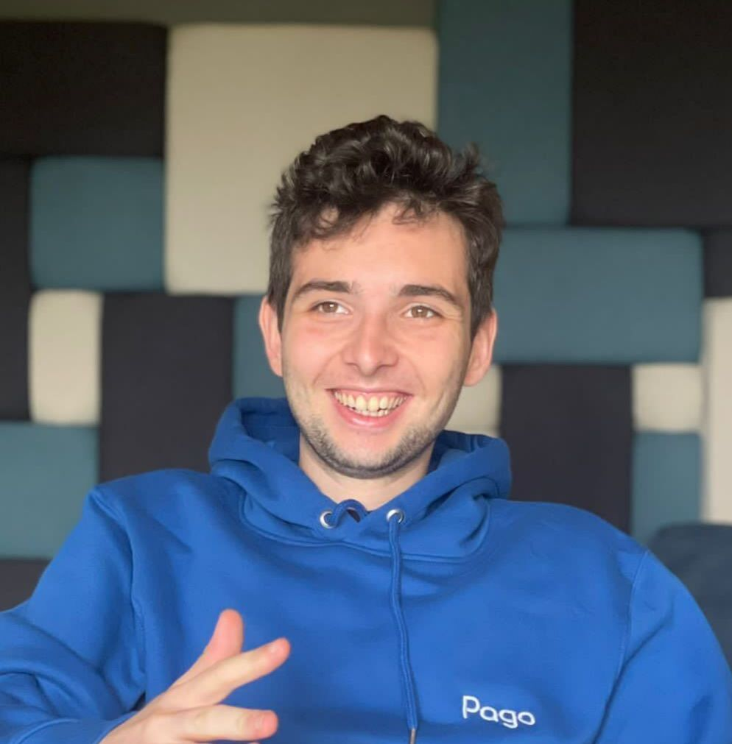
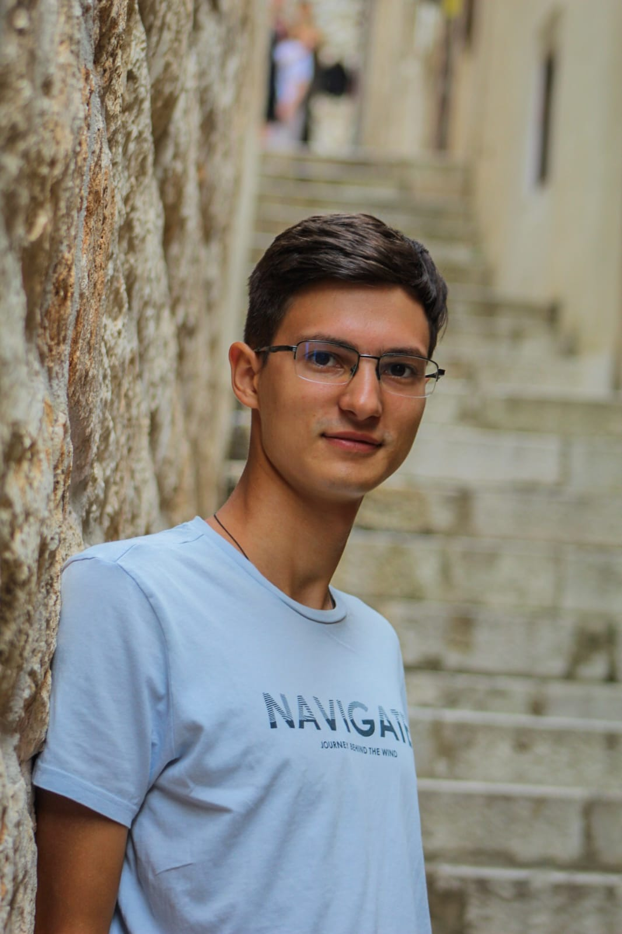
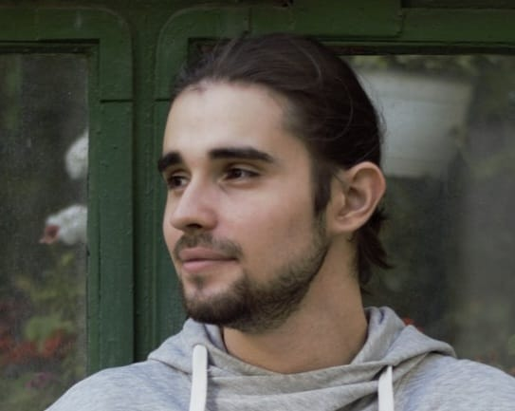
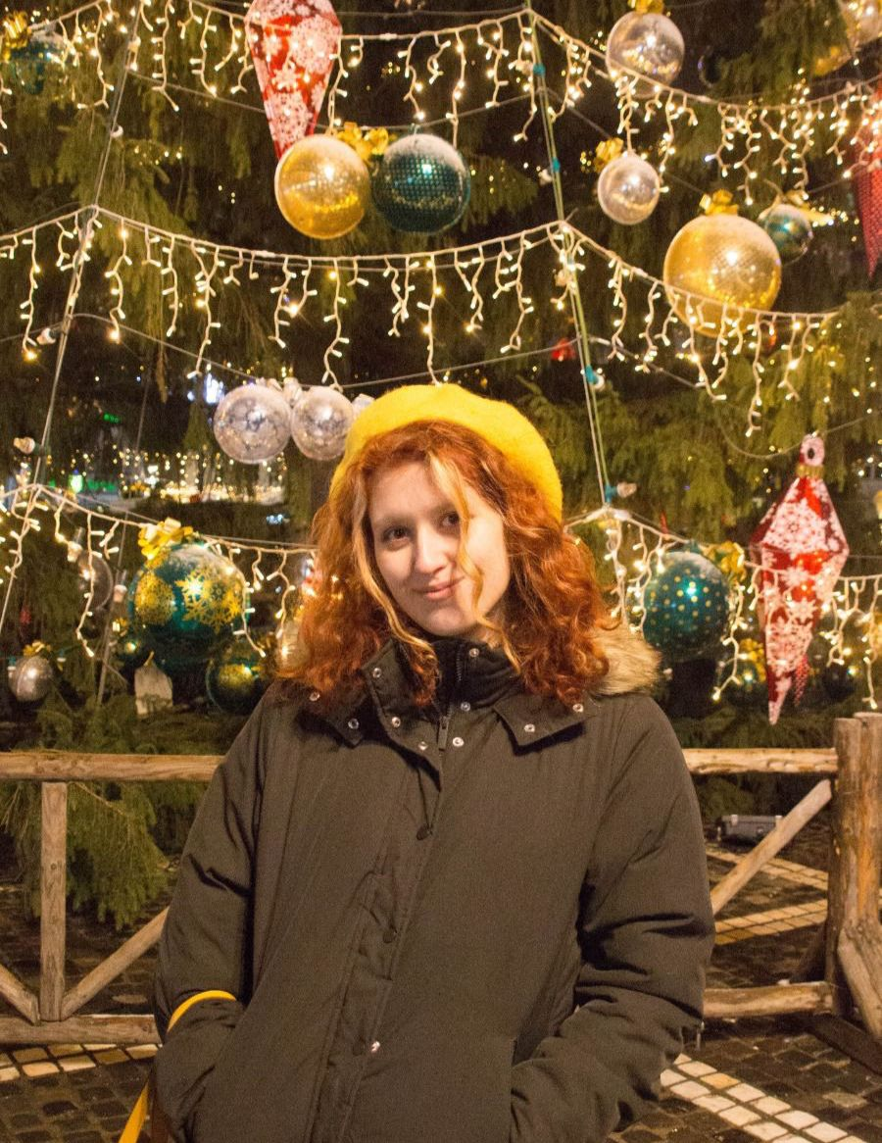
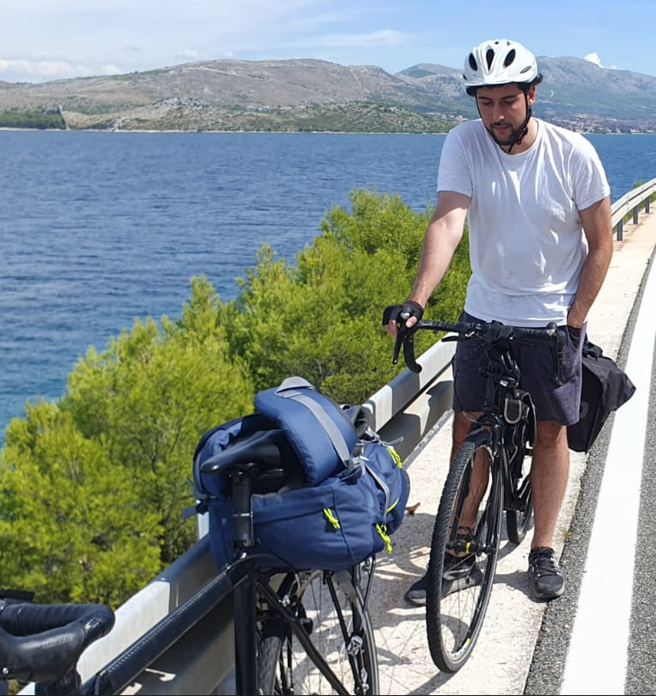
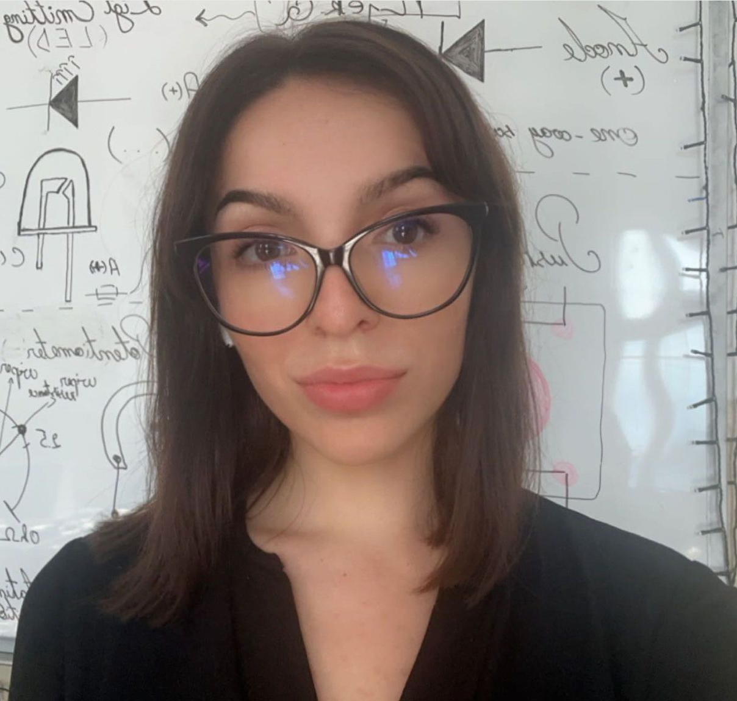

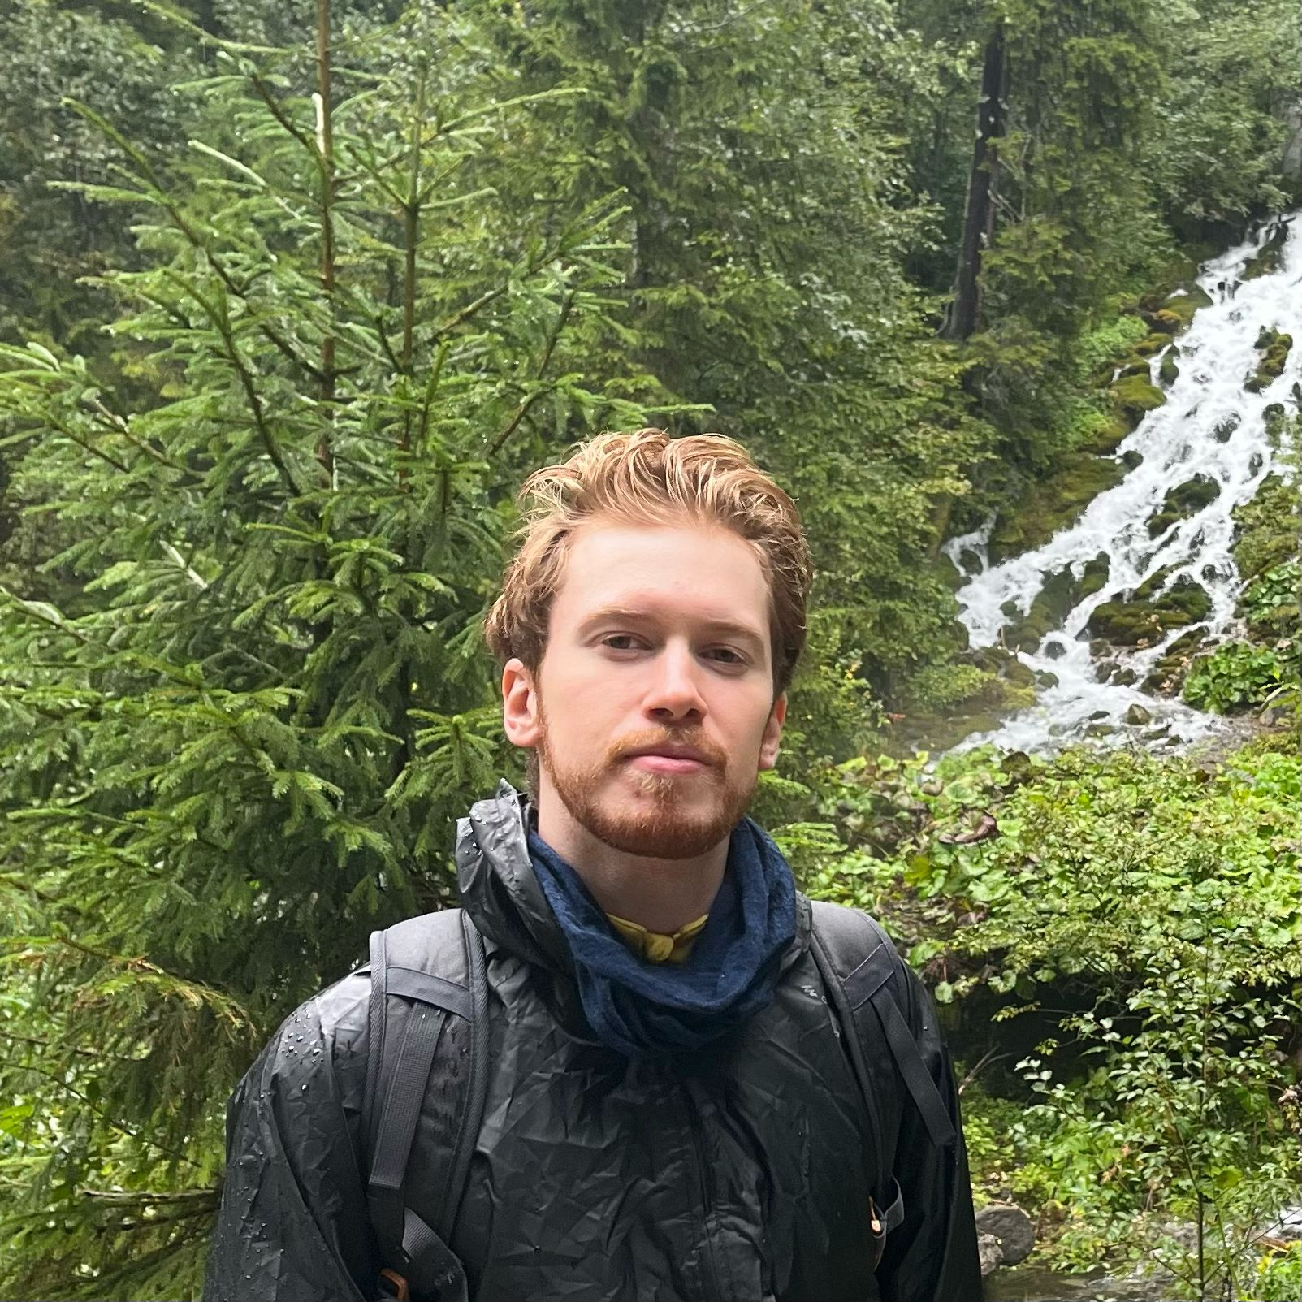

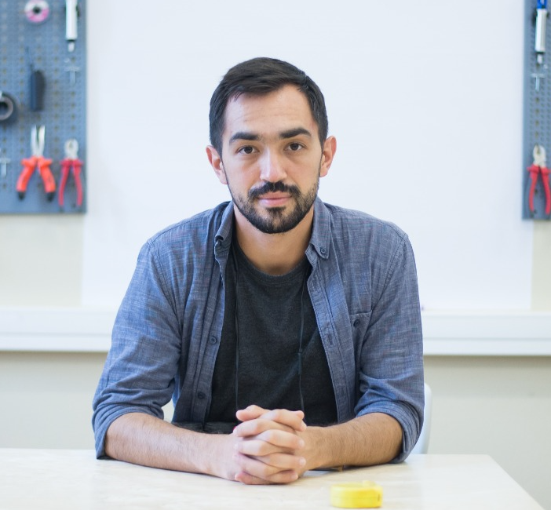
Meet the team
Adrian Pascu
Alexandru Surdu-Bob
Alexandru Sasu
Alexandra Ion
Andrei Duta
Dana Dascalescu
Ioana Livia Popescu
Radu Dilirici
Vlad Toader
Andrei Dumitriu

Slide 6
About the course: details
In-person laboratories (mandatory presence)
In-person courses (mandatory presence)
Hands on projects
Focus on actually delivering the projects - coding style, finishing touches etc
Going from 95% to 100% on a project

Slide 7
About the course: details
Grading:
1p laboratory, course and/or relevant extra-curricular activity
4p weekly homeworks
2.5p project 1: matrix game (bomberman, tetris etc)
2.5p project 2: line follower
1p: bonus (activities and/or anything extra on the ones above)
Total: 11p

Slide 8
About the course: attendance
Laboratories: 100%. You’re allowed for maximum 2 non-crucial absences, but those labs must be re-took (or strong evidence of individual completion)
Course: 50% + 1
These are fixed requirements and are non-negociable
Some labs are “in-cascade”. If you miss it and do not re-take it in time, you are not allowed to take part in the next one

Slide 9
About the course: passing
Minimum conditions:
5p total (4.99p = failing)
Met attendance requirements on both course and lab
You must wear protection glasses and respect the laboratory rules at all times in the lab (no joke)
Turn-in the kit a the end

Slide 10
About the course: failing
Upon failing (aka restanță):
Written exam, closed book, on paper
Subjects similar (but not limited to):
write a diagram,
correct a diagram,
correct the mistake in a code snippet,
explain differences between technical stuff (like timers, interrupts etc),
re-write a code using specific design patterns
etc
Depending on available resources on that specific year, you can re-take the entire course and meet that year’s requirements (similar to this one)
ProTip: you do not want to fail this course. Having a paper exam on electronics, design patterns, diagrams and microcontrollers overall - without having the practical experience - means you’re gonna have a bad time.

Slide 11
Course details: the bad
Mandatory presence: if you have trouble with that DO NOT TAKE THIS COURSE. I insist. (umm, too late?)
It’s fun, but hard and involves quite a lot of work.
You’ll hate - and hopefully love - the matrix project. But hate for sure.
I’m very insisting and sticky. I’ll call you if you don’t show up for a laboratory (not joking).
If you’re late, the entire lab is gonna wait for you.
A lot of attention to details on writing code, project structure and so on. I’ll always find something to pick one. Nobody ever receives a perfect 10 without bonus points. (I’m still hoping tho’)

Slide 12
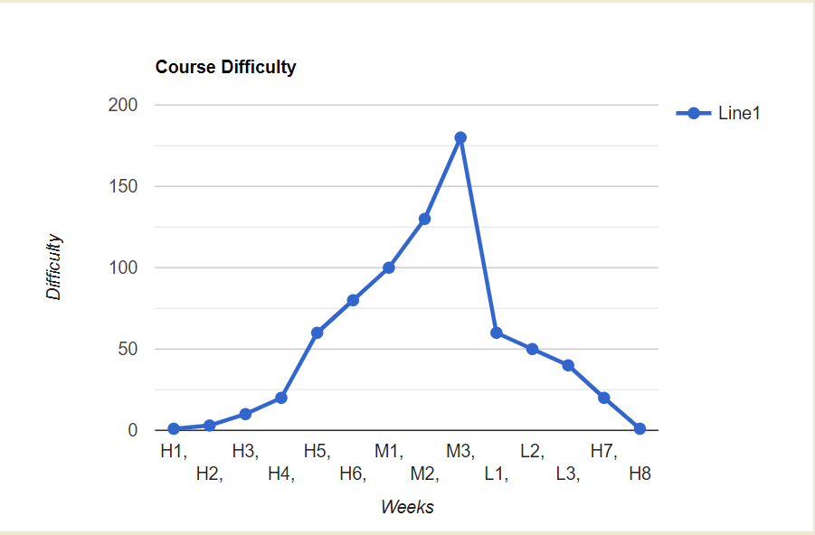
Course details: the ugly
See? It’s easy, just climb the steps
Just informative, don’t take it to heart

Slide 13
Course details: the good
It’s challenging and rewarding.
You’ll probably learn a lot more than the actual destination of the course.
Insights about startups, the industry, research, how to write a CV and what options are out there.
You’ll receive some strict code review that will help you further your career path.
Many students said that the projects in this course helped them land a great job, due to the clean code that’s required in their github, the documentation and the fact that the matrix project is one of the few complex and combined projects. Actual quote: “it makes us look smart”.

Slide 14
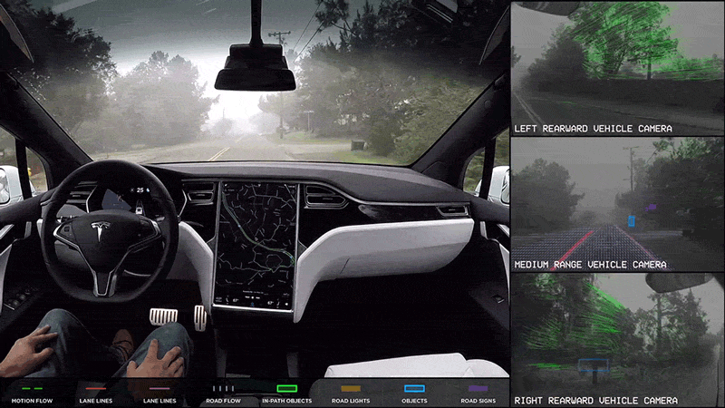
Sense. Analyse. Act.

Slide 15
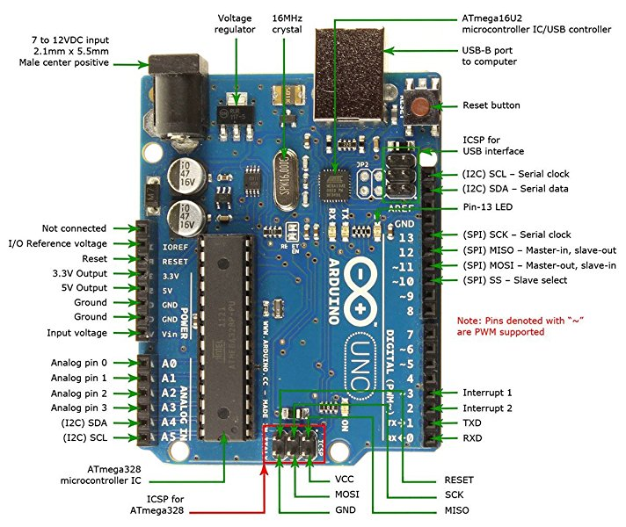
Arduino Uno board

Slide 16
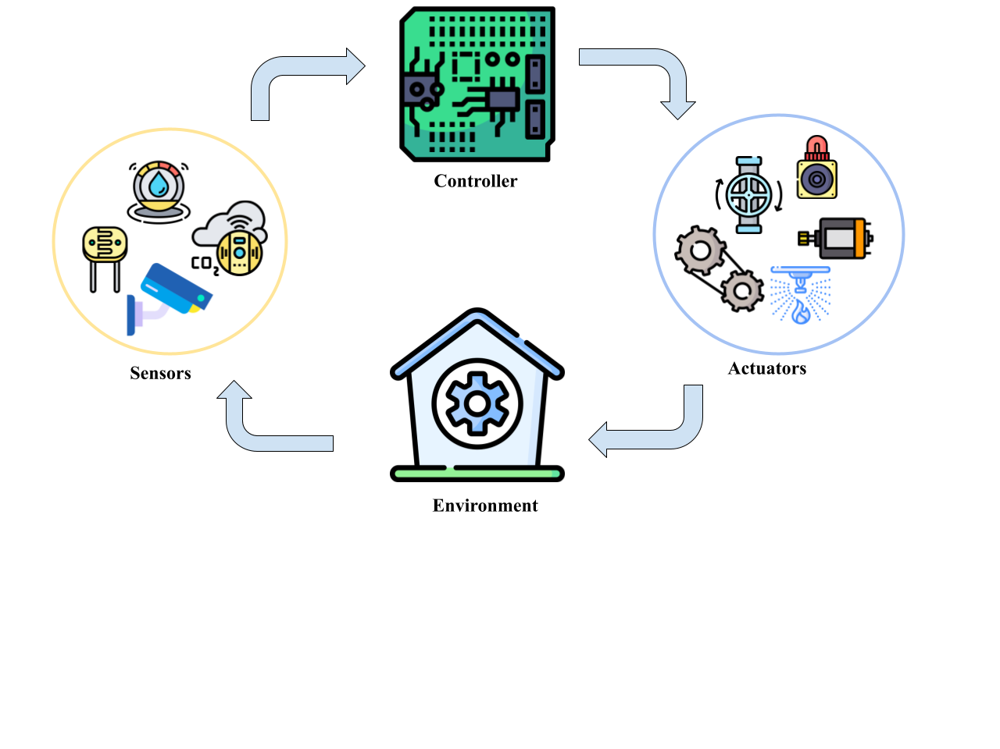
Sense. Analyse. Act.

Slide 17
About the course: hardware
Hardware & Interaction
Everything is provided, you are not expected to spend money on this course (only batteries if you want extra)
You ARE allowed to break stuff, as long as you do it with care
Our motto used to be “Acasa mergea”
You are encouraged to use the laboratories, equipment, 3D printers etc
Priority on printers: homework projects -> faculty projects -> I want to impress someone I like -> personal projects
Long story short, you are encouraged to use the equipment, even the perishable ones, even outside the course (to a reasonable degree)

Slide 18
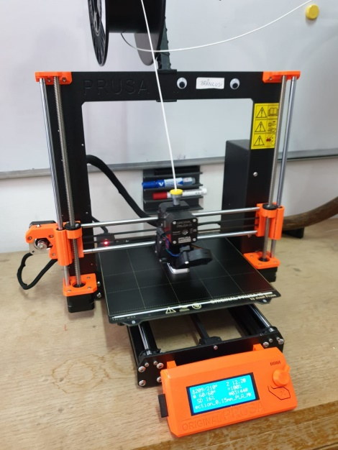
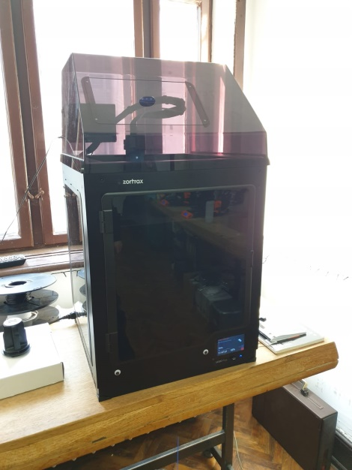
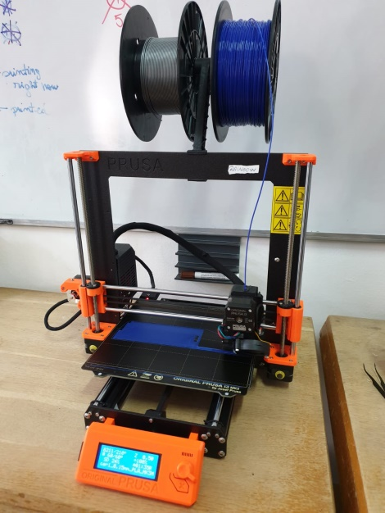
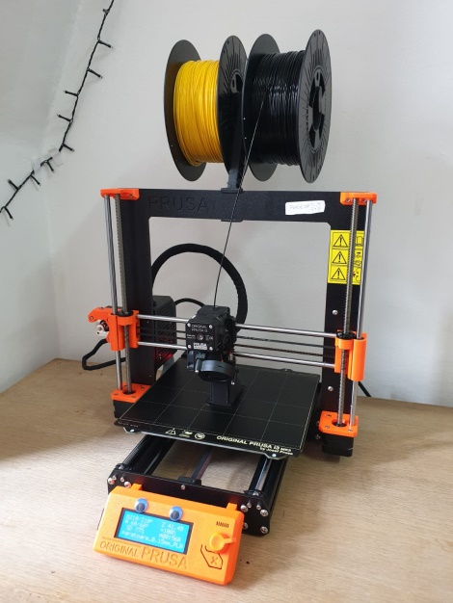
Equipment / Meet the printers
Rainbow
Purrsa (i3 MK3)
Purrsa
Brâncuși
Zotrax M300 Plus

Slide 19
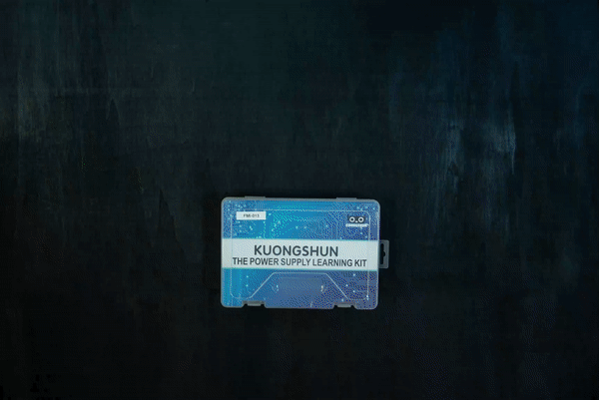
About the course: the kit

Slide 20
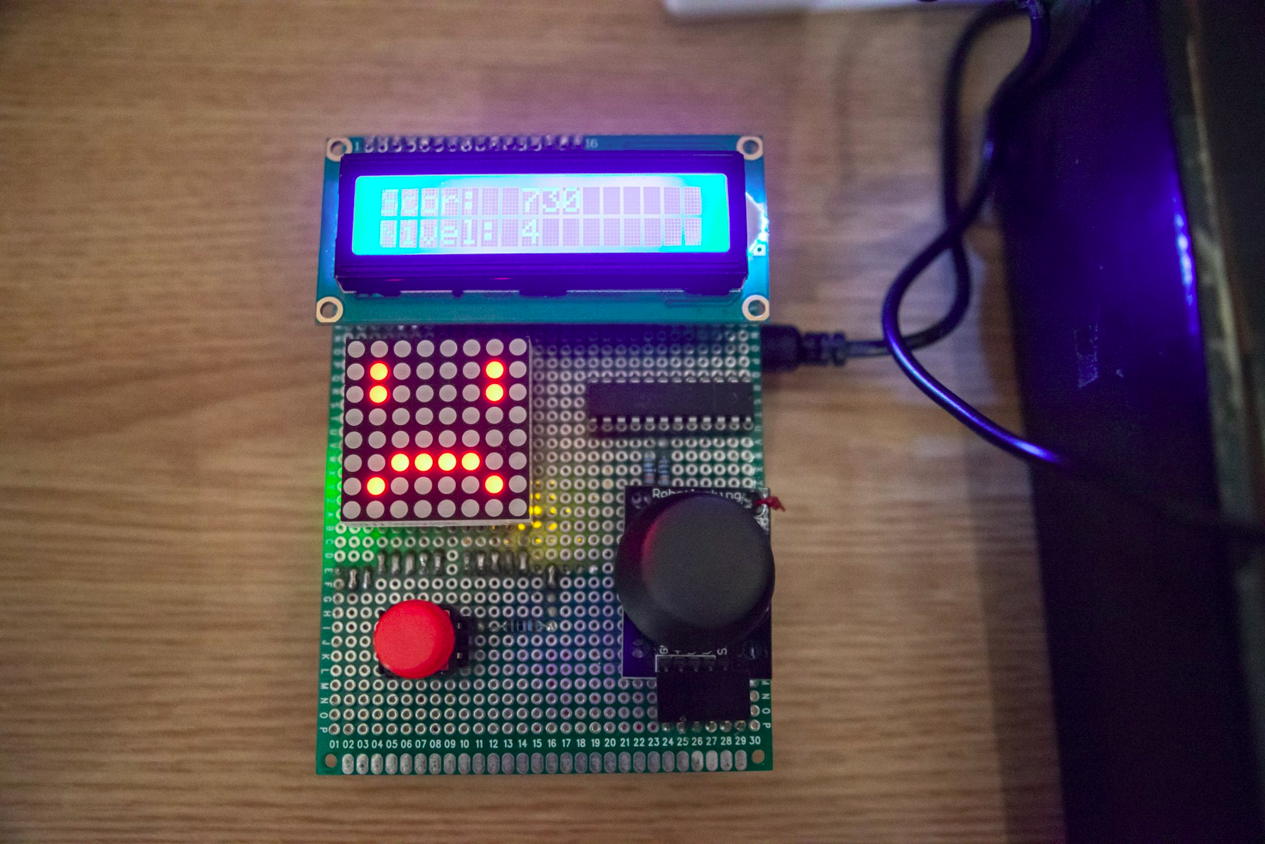
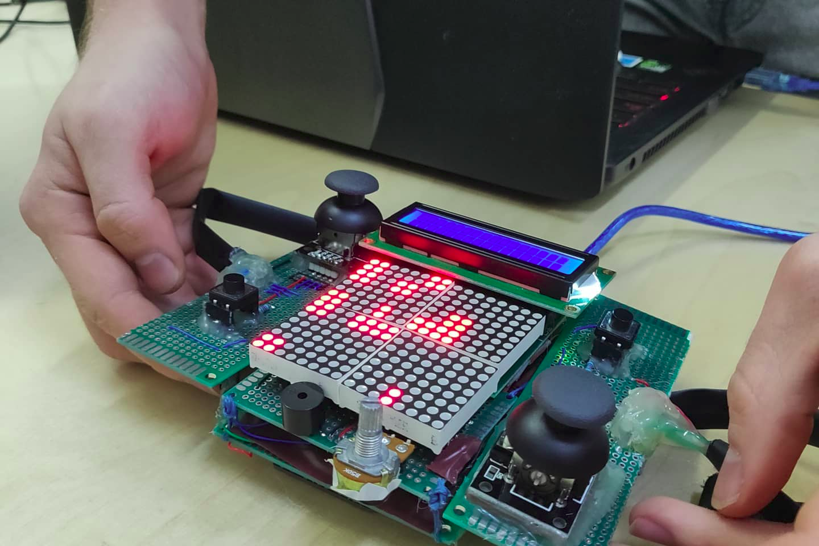
About the course: the matrix project

Slide 21
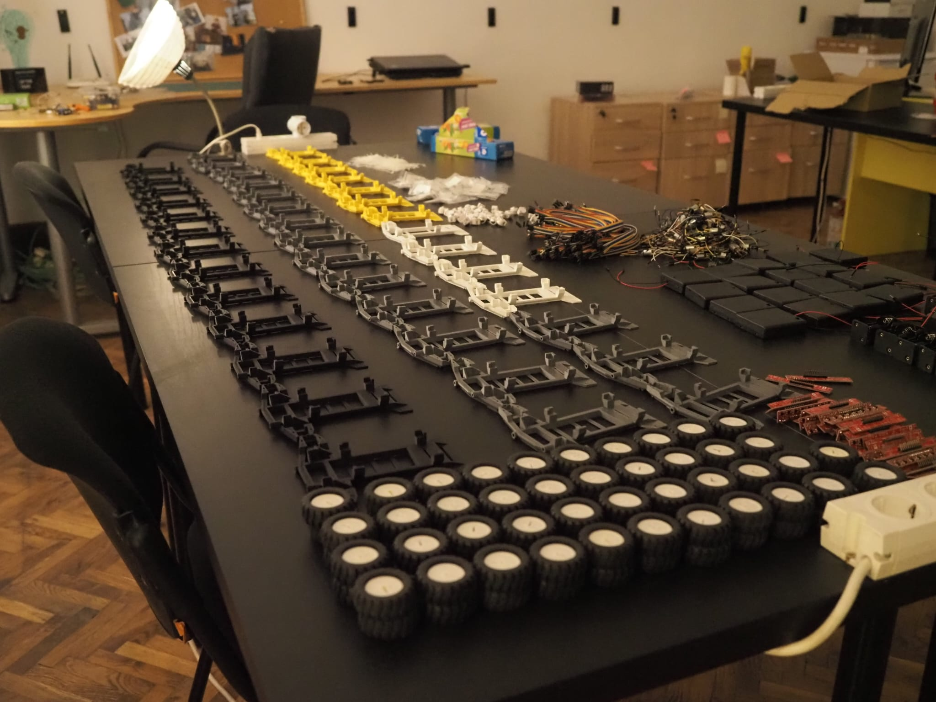
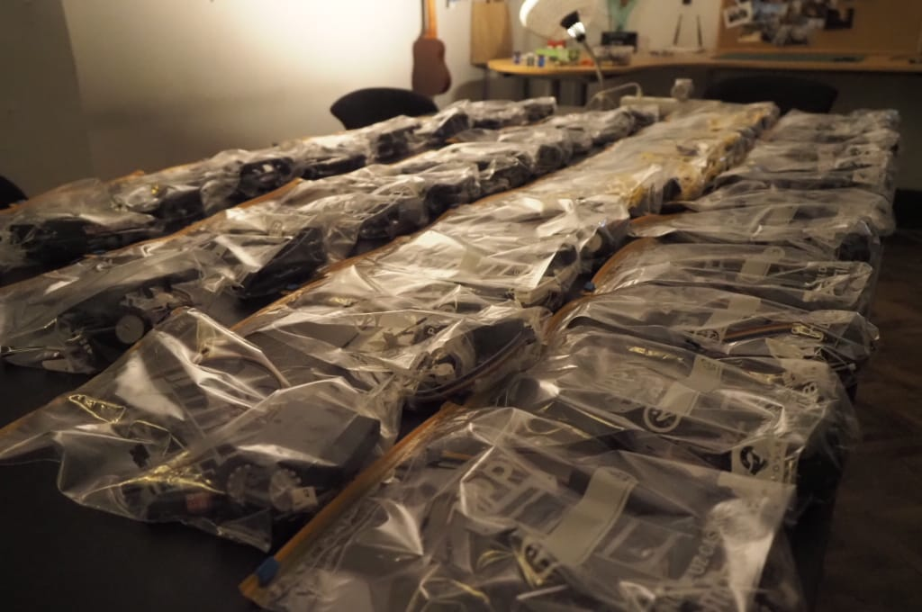
About the course: the line follower

Slide 22
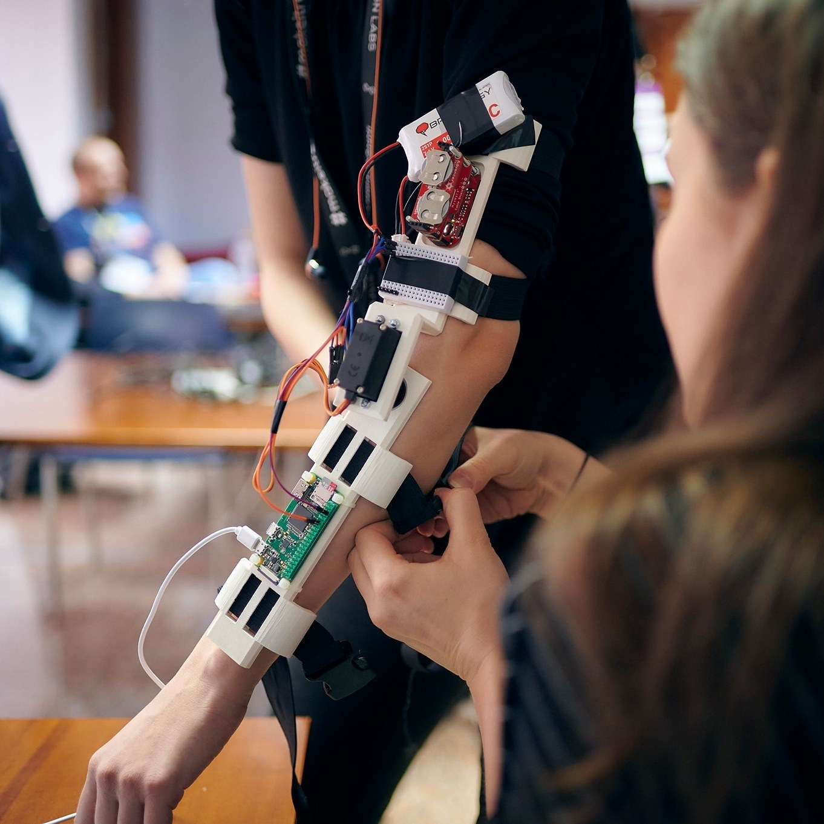
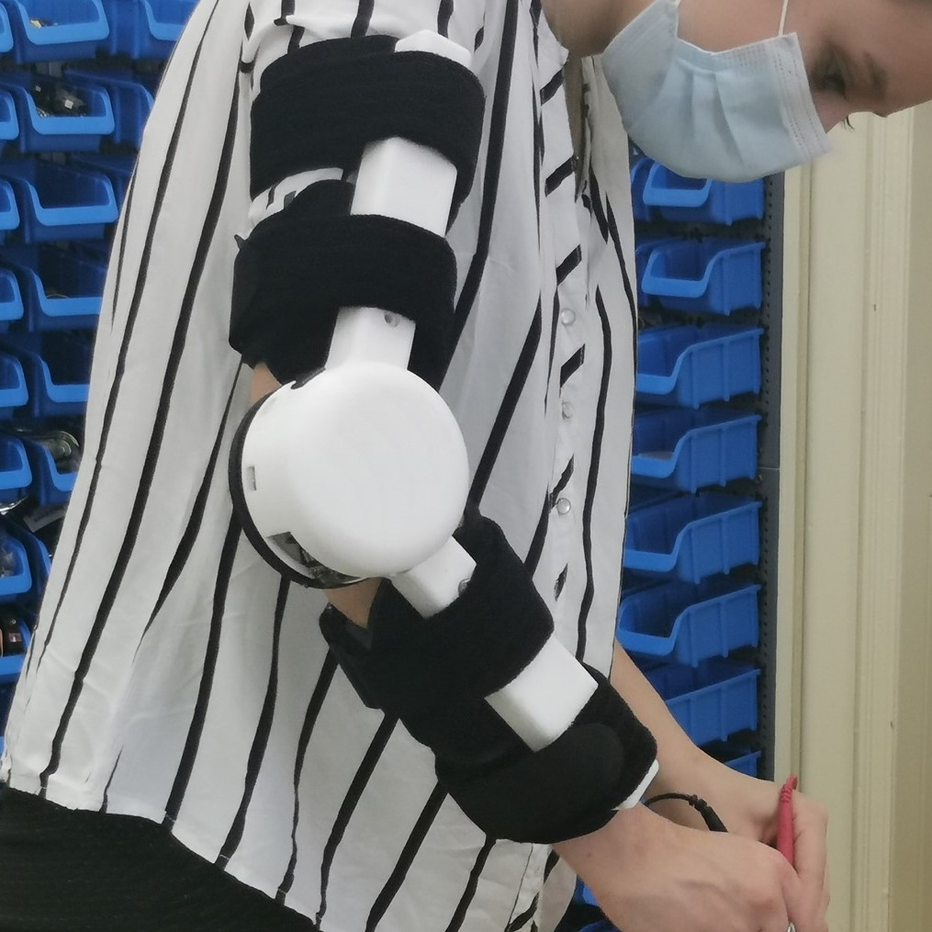
SCSS, InnovationLabs & IdeaJam

Slide 23
Some other projects we’re working on
InMoov Robot: https://www.youtube.com/watch?v=H4Z09edx52E
Bosch Future Mobility Challenge: https://boschfuturemobility.com/
Robochallenge: https://robochallenge.ro/
RC/RC Challenge maybe?
Course website (wordpress)
You can do your necessary apprenticeship in the lab

Slide 24
Homework #0
Join the Teams group
Complete the form
Create a github public repository as per the instructions that you will receive in the following email.
All homeworks have the same grade (0.4p). Don’t miss the easy ones!

Slide 25
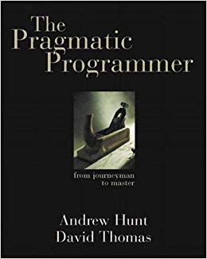
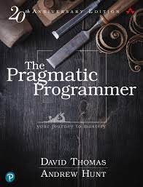
Some books
The pragmatic programmer
Read this and you’ll be a better programmer than most of your colleagues.
Read this and you’ll use good practices better than some of the managers you’ll encounter. Read this and you’ll be years ahead of the learning curve for your mean level.
Its techniques are applicable in other fields as well, not only programming.

Slide 26
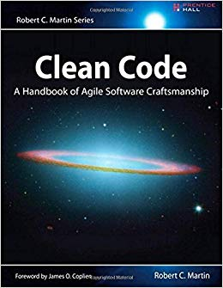
Some books
Clean code
Somewhat more technical, but excellent book on coding practices. Reading this and The pragmatic programmer will put you way ahead most programmers, even the ones with experience.

Slide 27
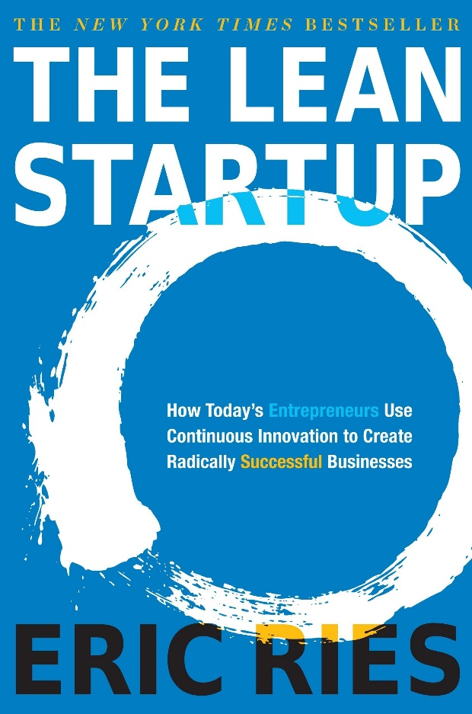

Some books
The lean startup & Zero to One
A must for anyone who wants to be part of a startup. Useful for absolutely anyone who will work in an organization. It will help you develop the entrepreneurial mindset. Some of THE books that shaped silicon valley. Most things that work there originated from here or are presented in these books.

Slide 28

Some books
Don’t make me think
Easy read, excellent book on designing web pages / application.
Even if you’re not interested in that, it packs useful information on how to design interactive tools

Slide 29

Some books
The design of everyday things
Goodreads describes this book as
“Anyone who designs anything to be used by humans -- from physical objects to computer programs to conceptual tools -- must read this book, and it is an equally tremendous read for anyone who has to use anything created by another human. It could forever change how you experience and interact with your physical surroundings, open your eyes to the perversity of bad design and the desirability of good design, and raise your expectations about how things should be designed.”
and I agree with it.

Slide 30

Some books
Rich dad, Poor dad
One of the most famous books on personal finances. Contains controversial statements about money – some might seem harsh and with some you might not agree, and that’s the point.
There are many books on personal finance, and this is one of them.

Slide 31

Attendance check

Slide 32
About us: the team
Aurelian Adrian Pascu
Contact
me.adi.hf@gmail.com
instgram.com/adi_random

Slide 33
About us: the team
Alexandru Surdu-Bob
1st year MS AI Student / FullStack Dev @ ALTEN Romania / Robotics, cars and music enthusiast
Contact:
alex.surdubob@gmail.com
instgram.com/alex.surdubob
linkedin.com/in/alexandru-surdu-bob/

Slide 34
About us: the team
Alexandra Ion
1st year DB master student / Full Stack Engineer @metro.digital
Contact:
alexion200123@gmail.com
linkedin.com/in/ion-alexandra/

Slide 35
About us: the team
Alexandru Sasu
1st year MS AI student / Video games and rock music enthusiast
Contact:
alexandru.sasu@s.unibuc.ro
linkedin.com/in/alexsasu/
facebook.com/alex.sasu.948

Slide 36
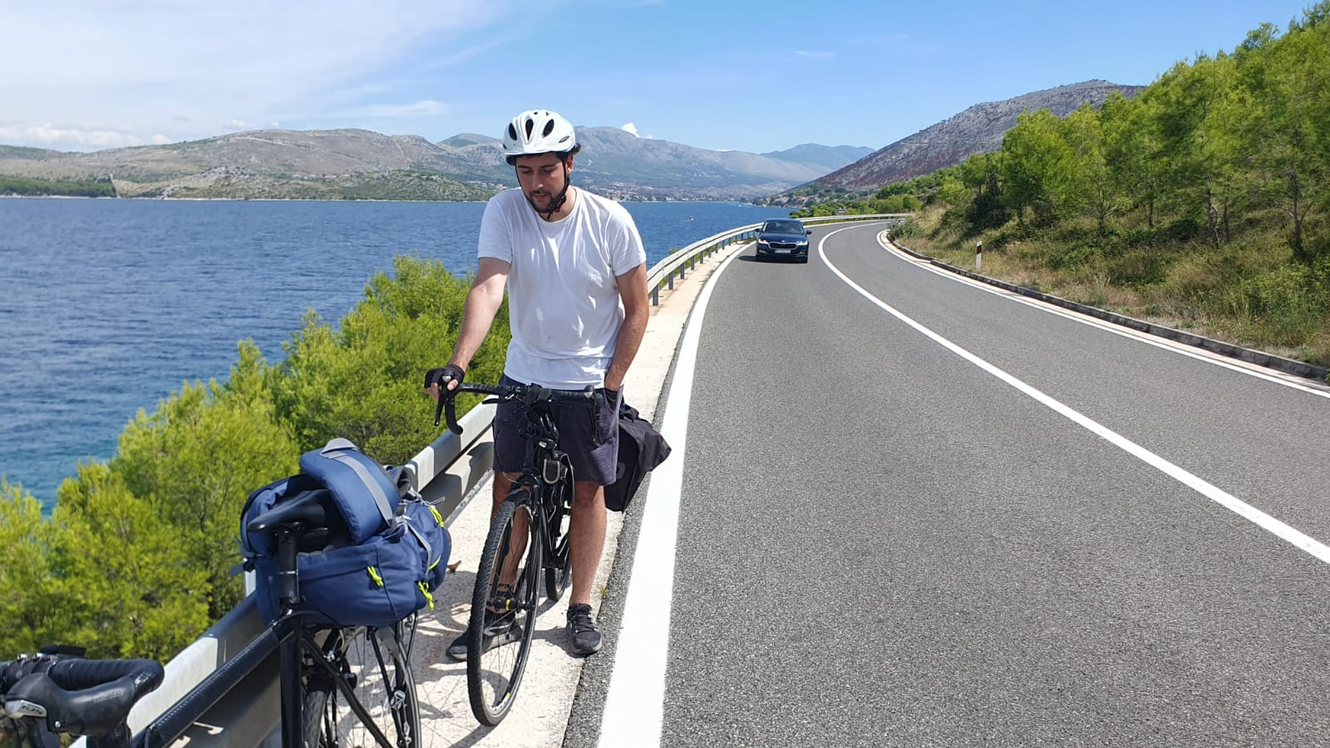
About us: the team
Andrei Duta
1st year MS AI Student / Software developer @ AMIQ EDA / Avid gamer, bike enjoyer, rap/rock fan
Contact:
discord: dandi08 (cea mai activa metoda)
dandi0801@gmail.com
facebook.com/profile.php?id=100010209223130
“Hello there! I am a friendly and patient person that loves to interact with people and laugh a lot. I am a big fan of games, from computer and board games to sports. I also enjoy a lot riding my bike and travelling. Have fun!”

Slide 37
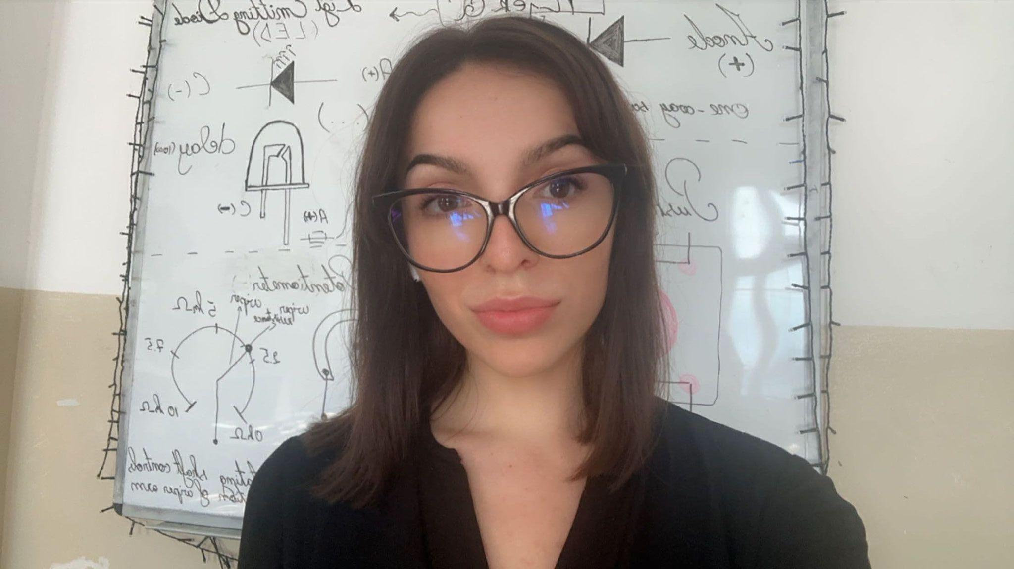
About us: the team
Dana Dascalescu
Contact
dana.dascalescu@s.unibuc.ro
https://www.facebook.com/dascalescu.dana
https://www.linkedin.com/in/dana-dascalescu/

Slide 38
About us: the team
Ioana Livia Popescu
1st year MS AI Student / Data Scientist Intern @GridDynamics / Boardgames enthusiast
Contact
ioanaaliviaa@gmail.com
linkedin.com/in/ioanaliviapopescu
“Am terminat Informatica vara aceasta, iar pentru mine Robotica a ramas cea mai fun materie de la licenta. Mult success in acest an, abia astept sa ne cunoastem 🤖 Fun fact, boardgame-ul meu preferat este Exploding Kittens.”

Slide 39
About us: the team
Radu Dilirici
SAL Master Graduate
Contact
diliriciradu@gmail.com
linkedin.com/in/radu-dilirici/
“I am neither especially clever nor especially gifted. I am only very, very curious.” - Albert Einstein

Slide 40

About us: the team
Vlad Toader
1st year MSc Databases & Software Tech student, also interested in AI
vinyl records collector & casual film photographer
Contact
toadervlad01@gmail.com / vlad.toader@s.unibuc.ro
facebook.com/vladfxstoader
linkedin.com/in/vladtoader
instagram.com/vladfxstoader

